Slide 1


Prediction of Parkinson's Disease

Slide 2
What is parkinsons?
Parkinson's disease is a progressive nervous system disorder that affects movement. Symptoms start gradually, sometimes starting with a barely noticeable tremor in just one hand. Tremors are common, but the disorder also commonly causes stiffness or slowing of movement. Most methods available can detect Parkinson in an advanced stage; which means loss of approx.. 60% dopamine in basal ganglia and is responsible for controlling the movement of the body with a small amount of dopamine.

Slide 3
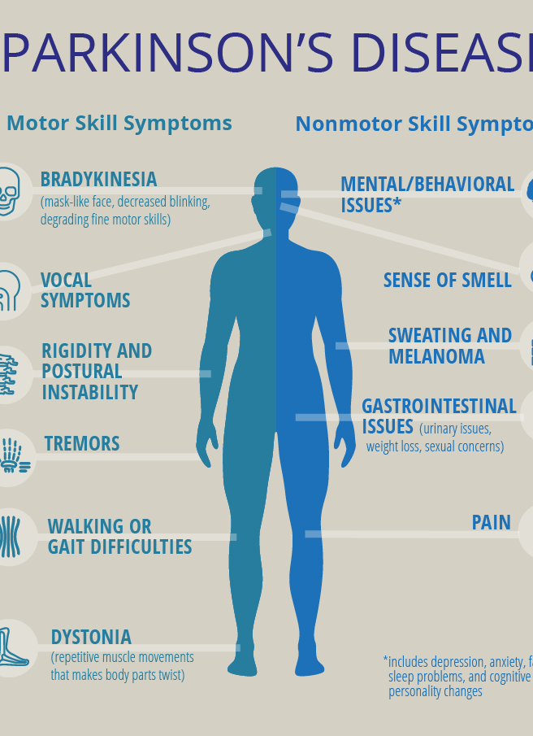
OBJECTIVE
The main objective of this project is to understand what is Parkinson’s disease and to detect the early onset of the disease. We will use here XGBoost, Support Vector Machines (SVMs), Neural network to anlyze and predict accuracies that different model provides.
We have started this project from an article we saw that used Xgboost and we decided it would be a good idea to see if any other models could give accuracies in that range

Slide 4
Dataset
Biomedical voice measurements from 31 people. 23 with Parkinson’s, and 8 without Parkinson’s.
6 recordings for each patients.
Status: 0 – No Parkinson’s, 1 – Parkinson’s
Independent Variables
Vocal fundamental frequencies(Avg, Max, Min)
Measures of variation in fundamental frequency
Measures of variation in amplitude
Measures of ratio of noise to tonal components in the voice
Dynamical complexity measures
Measures of fundamental frequency variation

Slide 5
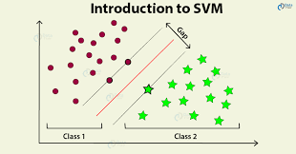
Support Vector Machines
Support Vector Machine, a statistical learning theory which transforms the data in a higher dimension. It finds a hyper plane to separate data using support vectors. It uses this plane to differentiate between a healthy and an infected patient and thus allows us to detect disease at the early onset by analyzing voice recordings.

Slide 6

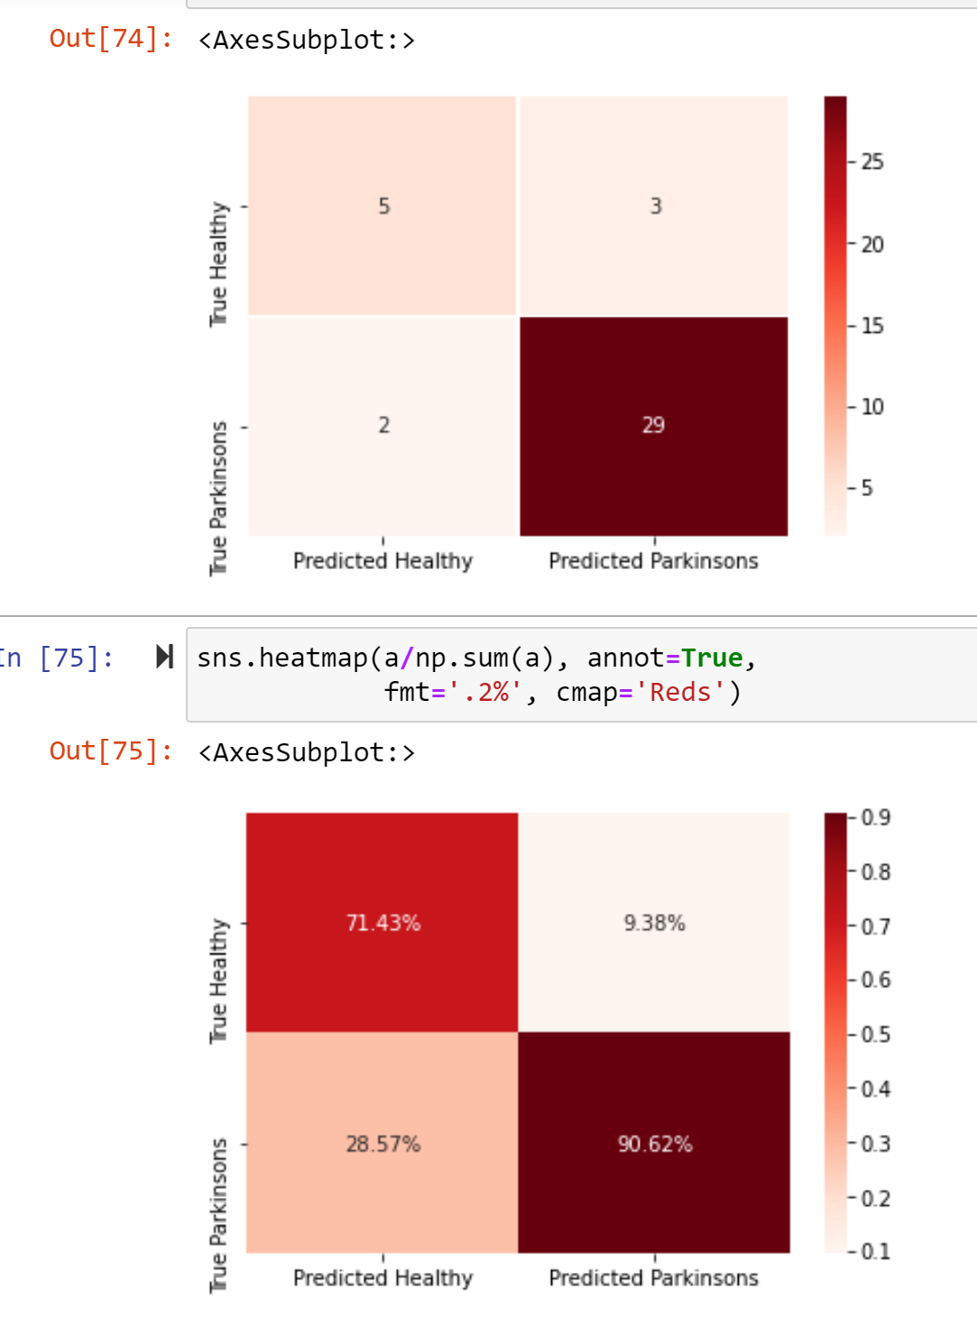



Visualizations for SVM
The F1 Score of the model is 0.9206349206349206
The Accuracy of the model is 0.8717948717948718
Accuracy score of training data : 0.8846153846153846
Accuracy score of test data : 0.8717948717948718

Slide 7
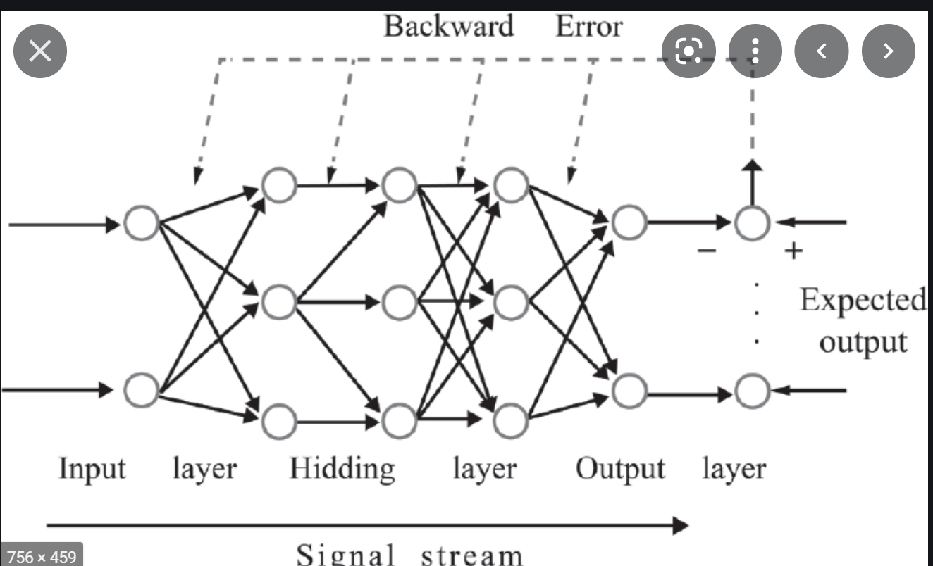
Neural Networks
Neural Networks are a class of machine learning algorithms to model complex patterns in datasets which uses multiple hidden layers and non-linear activation functions through a process that mimics the way the human brain operates. They can learn and model the relationships between inputs and outputs that are nonlinear and complex; make generalizations and inferences; reveal hidden relationships, patterns and predictions; and model highly volatile data.

Slide 8
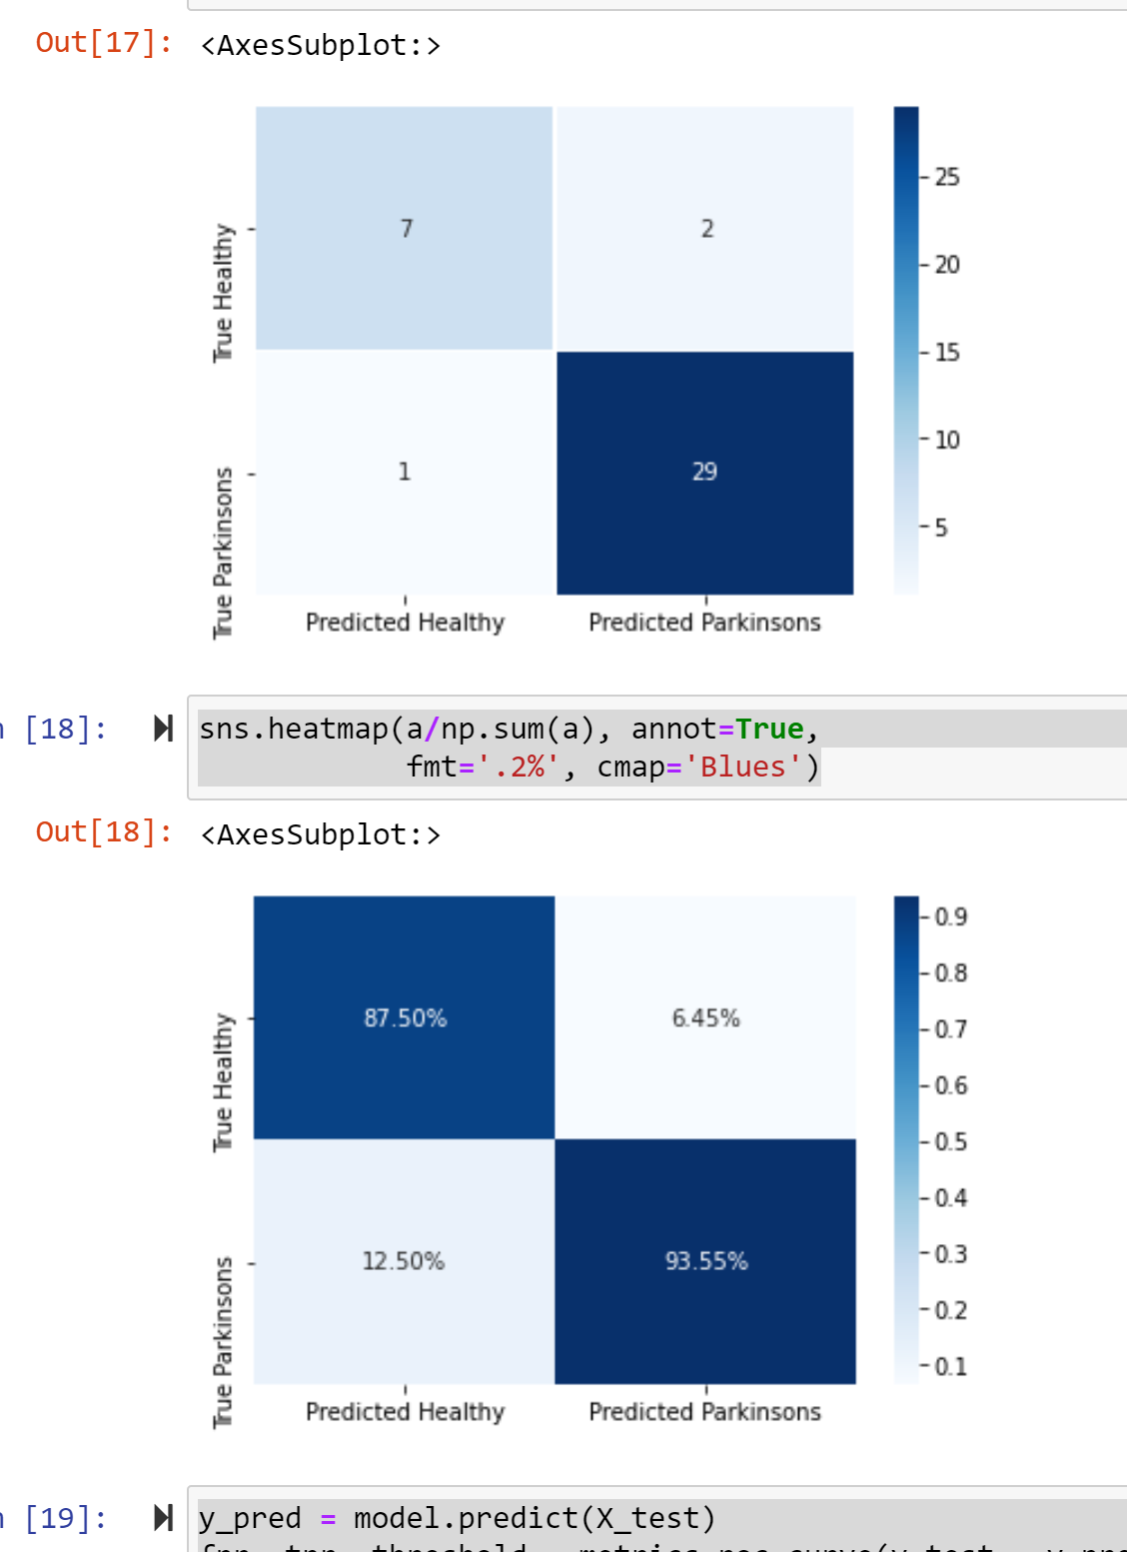
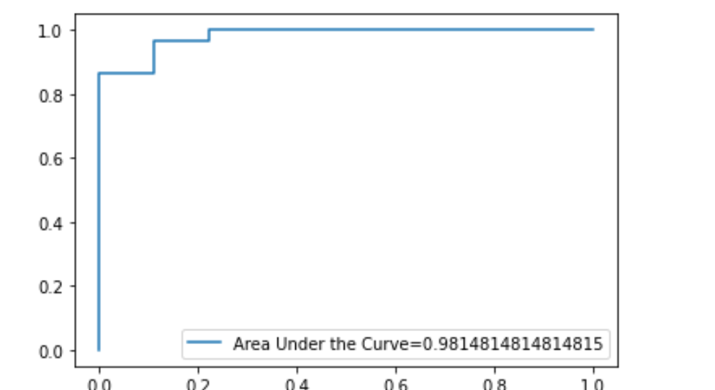
Visualizations for Neural Networks
The F1 Score of the model is 0.9508196721311476
In [21]:
The F1 Score of the model is 0.9508196721311476
The Accuracy of the model is 0.9230769230769231

Slide 9
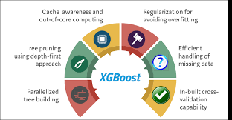
XGBOOST
XGBoost is a decision-tree-based ensemble Machine Learning algorithm that uses a gradient boosting framework. In prediction problems involving unstructured data (images, text, etc.) ... A wide range of applications: Can be used to solve regression, classification, ranking, and user-defined prediction problems. Ensemble learning is the process by which multiple models, such as classifiers or experts, are strategically generated and combined to solve a particular computational intelligence problem.

Slide 10
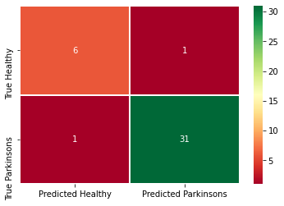
Visualizations for XG
The F1 Score of the model is 0.969696
The Accuracy of the model is close to 94%

Slide 11
Logistic Regression
Logistic Regression is a Machine Learning classification algorithm that is used to predict the probability of a categorical dependent variable. In logistic regression, the dependent variable is a binary variable that contains data coded as 1 (yes, success, etc.) or 0 (no, failure, etc.). In other words, the logistic regression model predicts P(Y=1) as a function of X.
Logistic Regression Assumptions
Binary logistic regression requires the dependent variable to be binary.
For a binary regression, the factor level 1 of the dependent variable should represent the desired outcome.
Only the meaningful variables should be included.
The independent variables should be independent of each other. That is, the model should have little or no multicollinearity.
The independent variables are linearly related to the log odds.
Logistic regression requires quite large sample sizes.

Slide 12
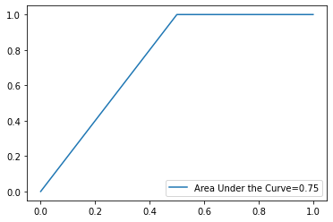
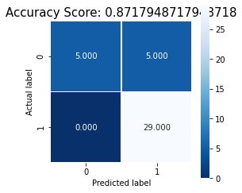
Visualizations for Logistic Regression
The F1 Score of the model is 0.9206349206349206
Precision: 0.853
Recall : 1.000
The score for our logistic regression model is 0.8717948717948718. This is not as high as the rest of our models.
Confusion Matrix for logistic regression
[[ 5 5]
[ 0 29]]

